Slide 1
BCSE101E Computer Programming : Python Module 1 Problem Solving: Definition and Steps, Problem Analysis Chart, Developing an Algorithm, Flowchart and Pseudocode.
Dr. A. Nayeemulla Khan

Slide 2
Skills Required for a Software Engineer
Technical Skills
Software Design
Coding
Testing
Problem Solving Skills
logical and analytical thinking
Soft Skills
Communication
Team Work

Slide 3
Problem
Problem is a puzzle that requires logical thought and /or mathematics to solve.
A puzzle could be a set of questions on a scenario which consists of description of reality and set of constraints about the scenario. Example Scenario: VIT Chennai campus has a library. The librarian issues books only to VIT employees. Careful observation suggests... Description of reality : There is a library in VIT Chennai campus and there is a librarian in the library.

Slide 4
Problem
Constraint : Librarian issues books only to VIT employees Questions about the scenario: 1 How many books are there in the library? 2 How many books can be issued to an employee? 3. Does the librarian issue a book to himself? etc

Slide 5
Case study - Discussion
Have you ever observed this scenario? Yes!!! What are the problems in the scenario?

Slide 6
Types of Problems
All Problems do not have a straightforward solutions.
Some problems, such as balancing a checkbook or baking a cake, can be solved with a series of actions.
These solutions are called algorithmic solutions.
There may be more than one solution for a problem
Identify all possible ways to solve a problem and choose one among them

Slide 7
Types of Problems
The solutions of other problems, such as how to buy the best stock or whether to expand the company, are not so straightforward.
These solutions require reasoning built on knowledge and experience, and a process of trial and error.
Solutions that cannot be reached through a direct set of steps are called heuristic solution

Slide 8
Problem Solving with Computers
Computers are built to solve problems with algorithmic solutions, which are often difficult or very time consuming when input is large
Solving a complicated calculus problem or alphabetizing 10,000 names is an easy task for the computer
So the basis for solving any problem through computers is by developing an algorithm

Slide 9
Field of computers that deals with heuristic types of problems is called Artificial Intelligence (AI)
Artificial intelligence enables a computer to do things like human by building its own knowledge bank
As a result, the computer’s problem-solving abilities are similar to those of a human being.
Artificial intelligence is an expanding computer field, especially with the increased use of Robotics.

Slide 10
Computational Problems
Computation is the process of evolution from one state to another in accordance with some rules.

Slide 11
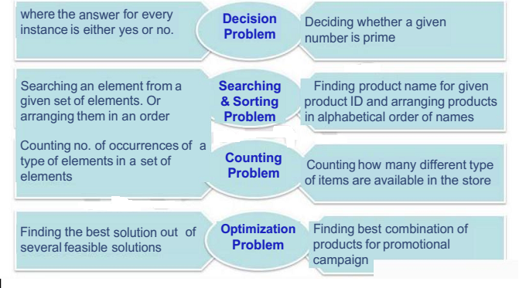
Types of Computational Problems

Slide 12
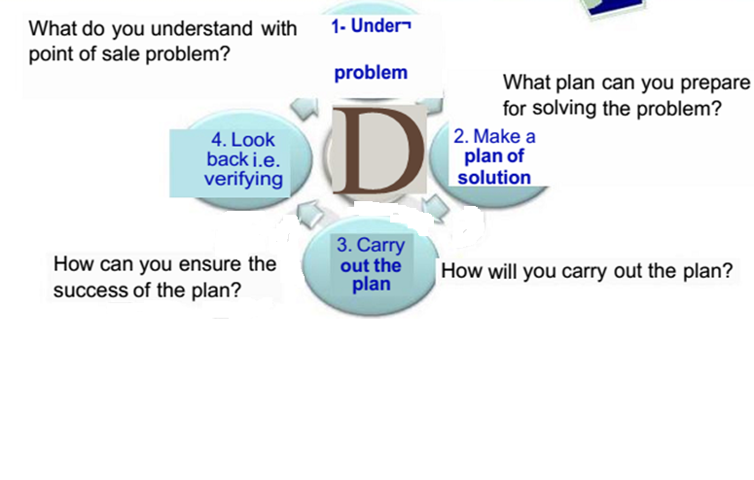
Problem Solving Life Cycle
For any problem solving strategy logic is prerequisite.

Slide 13
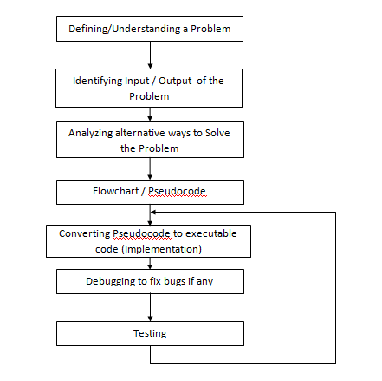

Slide 14
Logic – Basis for solving any problem
Definition : A method of human thought that involves thinking in a linear, step by step manner about how a problem can be solved
Logic is a language for reasoning.
It is a collection of rules we use when doing reasoning.
Eg: John's mum has four children.
The first child is called April.
The second May.
The third June.
What is the name of the fourth child?

Slide 15
What Problem Can Be Solved By Computer
Solving problem by computer undergo two phases:
Phase 1:
Organizing the problem or pre-programming phase.
Phase 2:
Programming phase.

Slide 16
PRE-PROGRAMMING PHASE
Analyzing The Problem
Understand and analyze the problem to determine whether it can be solved by a computer.
Analyze the requirements of the problem.
Identify the following:
Data requirement.
Processing requirement or procedures that will be needed to solve the problem.
The output.

Slide 17
PRE-PROGRAMMING PHASE
All these requirements can be presented in a Problem Analysis Chart (PAC)
Data | Processing | Output | Solution Alternatives
given in the problem or provided by the user | List of processing required or procedures. | Output requirement. | List of ideas for the solution of the problem.

Slide 18
PRE-PROGRAMMING PHASE
Payroll Problem
Calculate the salary of an employee who works by hourly basis. The formula to be used is
Salary = Hour works * Pay rate
Data | Processing | Output | Solution Alternatives
Hours work, Pay rate | Salary = Hours work * payrate | Salary | 1. Define the hours worked and pay rate as constants. ∗2. Define the hours worked and pay rate as input values.

Slide 19
Miles to Km
Write a Problem Analysis Chart (PAC) to convert
the distance in miles to kilometers where 1.609
kilometers per mile.
Data | Processing | Output | Solution Alternatives
Distance in miles | Kilometers = 1.609 x miles | Distance in kilometers | 1. Define the miles as constants. ∗2. Define the miles as input values.

Slide 20
Importance of Logic in problem solving
Determine whether a given number is prime or not?
Data | Processing | Output | Solution Alternatives
Number, N | Check if there is a factor for N | Print Prime or Not Prime | 1. Divide N by numbers from 2 to N and if for all the division operations, the reminder is non zero, the number is prime otherwise it is not prime 2. Same as 1 but divide the N from 2 to N/2 3. Same as Logic 1 but divide N from 2 to square root of N
Notes:
Example: Determine whether a given number is prime or not?
What is input?
What is Output?
What is the process involved to get the output from the input? What is the logic behind the process?

Slide 21
Importance of Logic in problem solving
In a fun game, MXM grid is given with full of coins. The player has to give a number 'N' of his choice. If N is lesser than M then he is out of game and doesn't gain any points. Otherwise he has to place all coins in the MXM grid in the NXN grid and he gains points equal to the number of free cells in the N X N grid.
Data | Processing | Output | Solution Alternatives
Numbers M and N | If N is less than M Points = 0 Otherwise Compute Points as N² - M² | Number of points gained | 1. Compute N² - M² as NXN – MXM 2. Compute (N + M) X (N – M) (Number of multiplication is reduced)
Notes:
Example: Determine whether a given number is prime or not?
What is input?
What is Output?
What is the process involved to get the output from the input? What is the logic behind the process?

Slide 22
Problem 2
Write a Problem Analysis Chart (PAC) to find an area of a circle where area = pi * radius * radius
Data | Processing | Output
radius | area = 3.14 x radius x radius | area

Slide 23
Problem 3
Write a Problem Analysis Chart (PAC) to compute and display the temperature inside the earth in Celsius and Fahrenheit. The relevant formulas are
Celsius = 10 x (depth) + 20
Fahrenheit = 1.8 x (Celsius) + 32
Data | Processing | Output
depth | celsius = 10 x (depth) + 20 fahrenheit = 1.8 x (celsius) + 32 | Display celsius, Display fahrenheit

Slide 24
Problem 4
Given the distance of a trip in miles, miles per gallon by the car that is used in the trip and the current price of one gallon of fuel (gas), write a program to determine the fuel required for the trip and the cost spent on the fuel.

Slide 25
Input | Processing | Output
Distance in miles, miles per gallon, cost per gallon | gas needed = distance / miles per gallon. estimated cost = cost per gallon x gas needed | Display gas needed Display estimated cost

Slide 26
HIPO Chart
Developing the Hierarchy Input Process Output (HIPO) or Interactivity Chart
When problem is normally big and complex.
Processing can be divided into subtasks called modules
Each module accomplishes one function
These modules are connected to each other to show the interaction of processing between the modules

Slide 27
HIPO Chart
Programming which use this approach (problem is divided into subtasks) is called Structured Programming
Main Module
Module 1
Module 2
Module 3
Module 4
Module 5
Module 6

Slide 28
HIPO Chart for Payroll Problem
PAYROLL
READ
CALCULATE
PRINT

Slide 29
Extended Payroll Problem
You are required to write a program to calculate both the gross pay and the net pay of every employee of your company. Use the following formulae for calculation:
Gross pay = number of hours worked * pay rate
Net pay = gross pay – deductions
The program should also print the cheque that tells the total net pay.

Slide 30
PAC for Extended Payroll Problem
Input | Processing | Output
Number of hours worked, pay rate, deductions | Gross pay = number of hours * pay rate Net pay = Gross pay – deductions | Net pay and write net pay in cheque

Slide 31
HIPO Chart
Payroll
0000
Calculate
Gross Pay
1000
Calculate
Net Pay
2000
Write
Cheque
3000
Get
Hourly
Worked
1100
Get
Pay rate
1200
Calculate
Deductions
2100

Slide 32
Temperature of Earth
Write a Hierarchy Input Process Output (HIPO) to compute and display the temperature inside the earth in Celsius and Fahrenheit. The relevant formulas are
Celsius = 10 x (depth) + 20
Fahrenheit = 1.8 x (Celsius) + 32
Temperature
0000
Calculate temperature
in celsius
1000
Get depth
1100
Calculate temperature
In fahrenheit
2000
Display
Temperature
3000

Slide 33
Algorithm
Step by step procedure to solve a problem
'In Computer Science following notations are used to represent algorithm
Flowchart: This is a graphical representation of computation
Pseudo code: They usually look like English statements but have additional qualities

Slide 34
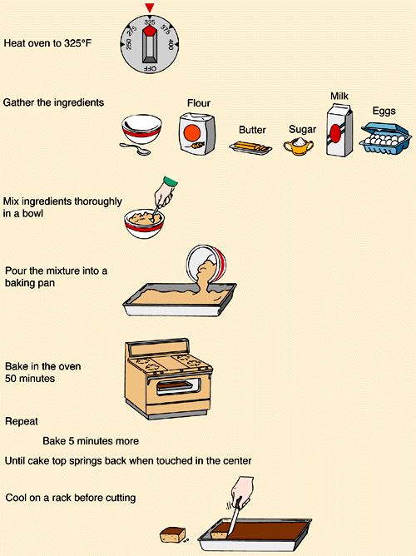

Slide 35
Algorithm
• Algorithms are not specific to any programming language
• An algorithm can be implemented in any programming language
• Use of Algorithms – Facilitates easy development of programs – Iterative refinement – Easy to convert it to a program – Review is easier

Slide 36
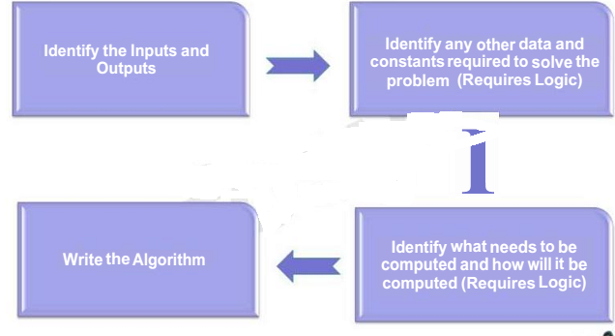
Steps to Develop an Algorithm

Slide 37
Algorithm for Real life Problem
PROBLEM: Heat up a can of soup
ALGORITHM:
1 open can using can opener
2 pour contents of can into saucepan
3 place saucepan on ring of cooker
4 turn on correct cooker ring
5 stir soup until warm
may seem a bit of a silly example but it does show us that the order of the events is important since we cannot pour the contents of the can into the saucepan before we open the can.

Slide 38
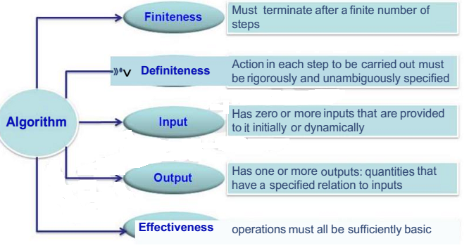
Properties of an Algorithm

Slide 39
Different patterns in Algorithm

Slide 40
Sequential Algorithms

Slide 41
Algorithm for adding two numbers
Step 1: Read two numbers A and B Step 2: Let C = A + B Step 3: Display C

Slide 42
Area of a Circle
Step 1 : Read the RADIUS of a circle Step 2 : Find the square of RADIUS and store it in SQUARE Step 3 : Multiply SQUARE with 3.14 and store the result in AREA
Step 4: Print AREA

Slide 43
Average Marks
Find the average marks scored by a student in 3 subjects: Step 1 : Read Marks1, Marks2, Marks3 Step 2 : Sum = Marks1 + Marks2 + Marks3 Step 3 : Average = Sum / 3 Step 4 : Display Average

Slide 44
Selectional Algorithms

Slide 45
Algorithm for Conditional Problems
PROBLEM: To decide if a fire alarm should be sounded
ALGORITHM:
1 IF fire is detected condition
2 THEN sound fire alarm action
Another example is:-
PROBLEM: To decide whether or not to go to school ALGORITHM:
1 IF it is a weekday AND it is not a holiday
2 THEN go to school
3 ELSE stay at home

Slide 46
Pass/ Fail and Average
Write an algorithm to find the average marks of a student. Also check whether the student has passed or failed. For a student to be declared pass, average marks should not be less than 65. Step 1 : Read Marks1, Marks2, Marks3 Step 2 : Total = Marks1 + Marks2 + Marks3 Step 3 : Average = Total / 3 Step 4 : Set Output = “Student Passed” Step 5 : if Average < 65 then Set Output = “Student Failed" Step 6 : Display Output

Slide 47
Leap Year or Not
Step 1 : Read YEAR Step 2 : IF ({YEAR%4=0 AND YEAR%100!=0)OR (YEAR%400=0)) Display "Year is a leap year" ELSE Display “Year is not a leap year" ENDIF

Slide 48
Algorithm for Iterative Problems
This type of loop keeps on carrying out a command or commands UNTIL a given condition is satisfied, the condition is given with the UNTIL command, for example:-
PROBLEM: To wash a car
ALGORITHM:
1 REPEAT
2 wash with warm soapy water
3 UNTIL the whole car is clean

Slide 49
Iterational Algorithms – Repetitive Structures
Find the average marks scored by ‘N’ number of students

Slide 50
Step 1 : Read Number Of Students Step 2 : Let Counter = 1 Step 3 : Read Marks1, Marks2, Marks3 Step 4 : Total = Marks1 + Marks2 + Marks3 Step 5 : Average = Total / 3 Step 6 : Set Output = “Student Passed” Step 7 : If (Average < 65) then Set Output = “Student Failed" Step 8 : Display Output Step 9 : Set Counter = Counter + 1 Step 10 : If (Counter <= NumberOfStudents ) then goto step 3

Slide 51
Bigger Problems
If you are asked to find a solution to a major problem, it can sometimes be very difficult to deal with the complete problem all at the same time.
For example building a car is a major problem and no-one knows how to make every single part of a car.
A number of different people are involved in building a car, each responsible for their own bit of the car’s manufacture.
The problem of making the car is thus broken down into smaller manageable tasks.
Each task can then be further broken down until we are left with a number of step-by-step sets of instructions in a limited number of steps.
The instructions for each step are exact and precise.

Slide 52
Top Down Design
Top Down Design uses the same method to break a programming problem down into manageable steps.
First of all we break the problem down into smaller steps and then produce a Top Down Design for each step.
In this way sub-problems are produced which can be refined into manageable steps.

Slide 53
Top Down Design for Real Life Problem
PROBLEM: To repair a puncture on a bike wheel. ALGORITHM:
1. remove the tyre
2. repair the puncture
3. replace the tyre

Slide 54
Step 1: Refinement:
Remove the tyre
1.1 turn bike upside down
1.2 lever off one side of the tyre
1.3 remove the tube from inside the tyre

Slide 55
Step 2: Refinement:
Repair the puncture Refinement:
2.1 find the position of the hole in the tube
2.2 clean the area around the hole
2.3 apply glue and patch

Slide 56
Step 3: Refinement:
3. Replace the tyre Refinement:
3.1 push tube back inside tyre
3.2 replace tyre back onto wheel
3.3 blow up tyre
3.4 turn bike correct way up

Slide 57
Still more Refinement:
Sometimes refinements may be required to some of the sub-problems, for example if we cannot find the hole in the tube, the following refinement can be made to 2.1:-

Slide 58
Still more Refinement:
Step 2.1: Refinement
2.1 Find the position of the hole in the tube
2.1.1 WHILE hole cannot be found
2.1.2 Dip tube in water
2.1.3 END WHILE

